Slide 1
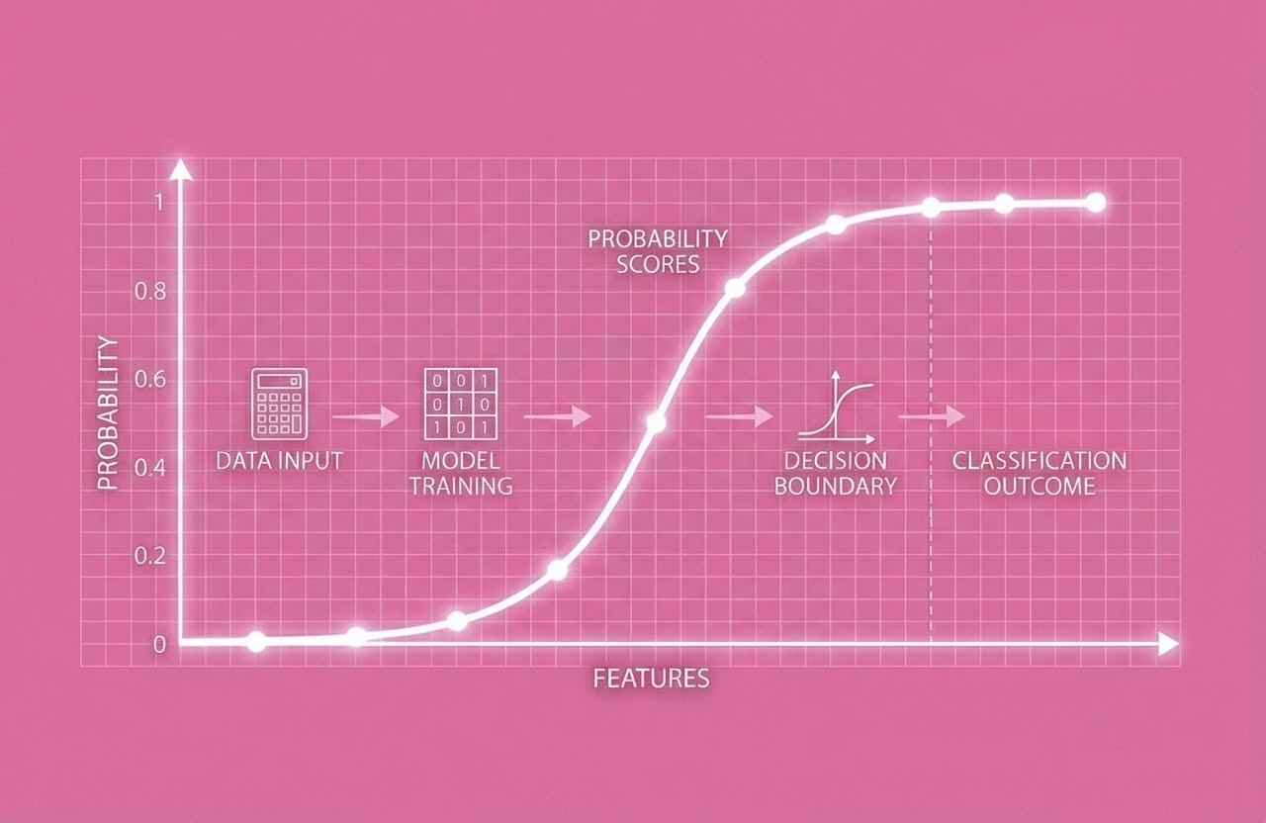

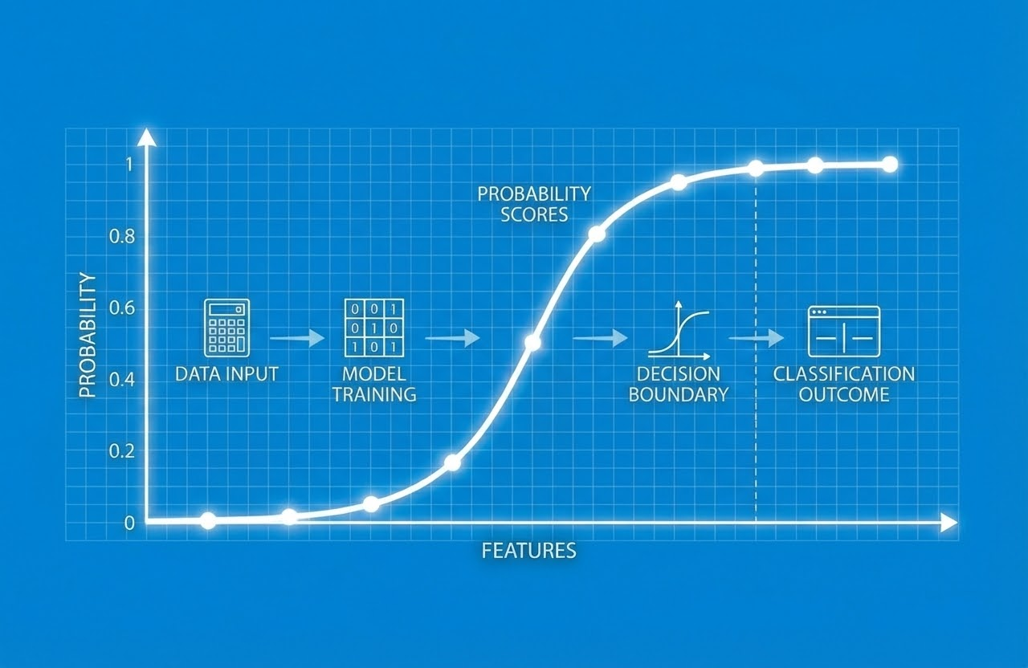
By: Ankur, Brian, Catherine,Imtiyaz
DANA 4820 Project
Notes:
Imtiyaz

Slide 2

Introduction
This project examines what factors influence students’ views on whether abortion should be legal in the first three months of pregnancy. Using survey data from University of Florida graduate students, we analyze demographic, behavioral, and ideological variables—such as gender, age, GPA, political affiliation, ideology, religious attendance, and media habits. Through logistic regression, we identify which variables are most strongly associated with abortion support.
Notes:
Imtiyaz

Slide 3
01
Dataset
Notes:
Imtiyaz

Slide 4
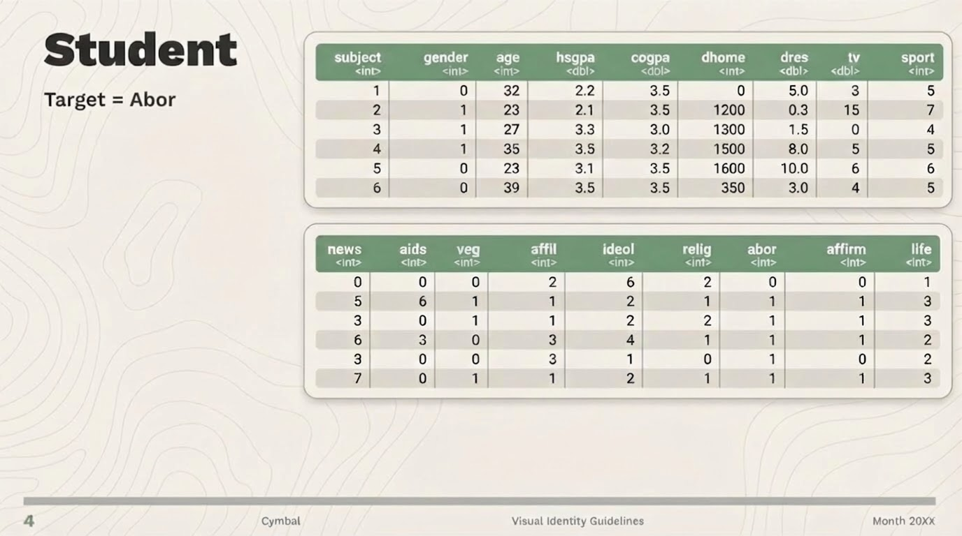
Notes:
Imtiyaz

Slide 5
By: Ankur, Brian, Catherine,Imtiyaz
DANA 4820 Project
Notes:
Imtiyaz

Slide 6
Introduction
Uses survey data from University of Florida graduate students.
Analyzes demographic, behavioral, and ideological variables.
Uses logistic regression to identify strongest predictors of abortion support.
Notes:
Imtiyaz

Slide 7
01
Dataset
Notes:
Imtiyaz

Slide 8
Notes:
Imtiyaz

Slide 9
02
EDA
Notes:
Brian
We cannot use this dataset directly, so we did the EDA to understand data pattern, relationship between variables and preparing dataset for modeling.

Slide 10
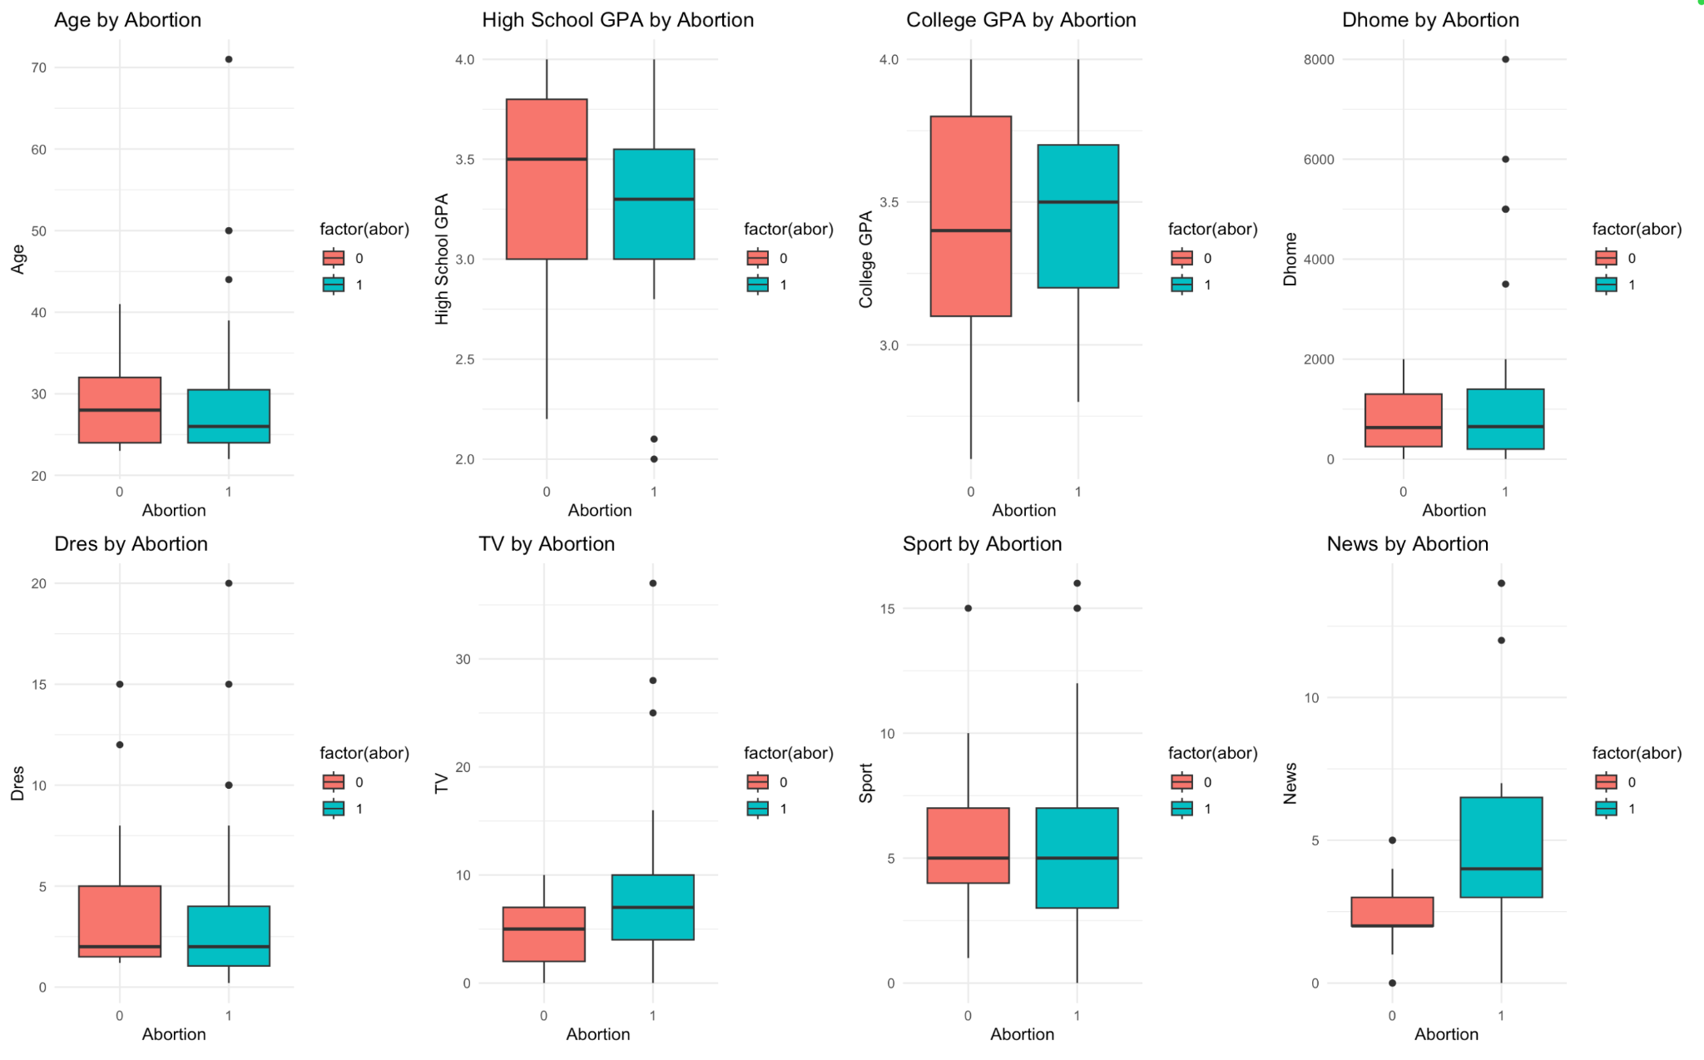
Numerical Variables
Notes:
Brian/Ankur
For numerical variables, we have only one graph that show the relationship between numerical and categorical variable is boxplot.
This slide shows each numerical variables versus abortion. As you can see, the graphs present a variety of trends. So next Ankur will explain each graph.

Slide 11
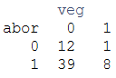
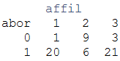
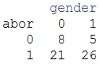
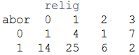
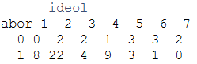
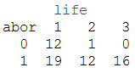
Categorical Variables
abor vs veg
abor vs affil
abor vs gender
abor vs relig
abor vs life
abor vs ideol
Notes:
Brian/Catherine
Moving to categorical variables, we did the contingency table to see relationship between categorical and target. for abor vs gender, gender 0 = male,1=female, abor 0=not support,1=support. Veg 0= non vegetarian 1= vegetarian, affiliation 1= who vote for the Democrat party, 2= for Republican and 3= who is independent from these two party

Slide 12
03
Stepwise
Notes:
Brian
After we understand pattern and relationship of variables, now we use a stepwise variable selection to select variable for our model.

Slide 13

Step 1: Construct Initial Main Effects Model
Notes:
Brian
Step 1 we Create Initial main effects model. It means we are finding which variables will be significance or useful predictor for the abortion support.

Slide 14
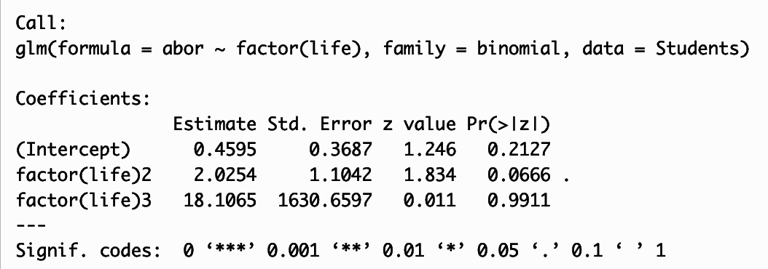
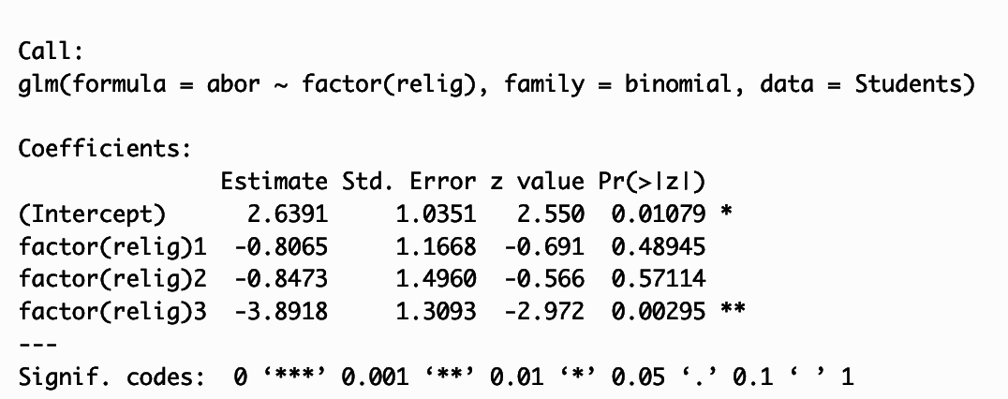
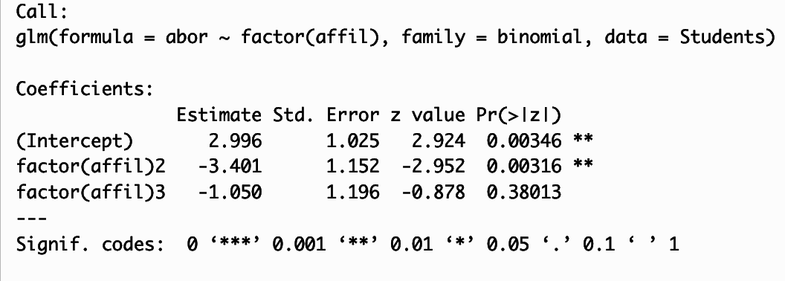
Dummy Variables
Life
Relig
affil2=ifelse(affil==2, 1, 0)
lifedummy=ifelse(life==1, 1 ,0)
Affil
religdummy=ifelse(relig==3, 1, 0)
Notes:
Catherine

Slide 15
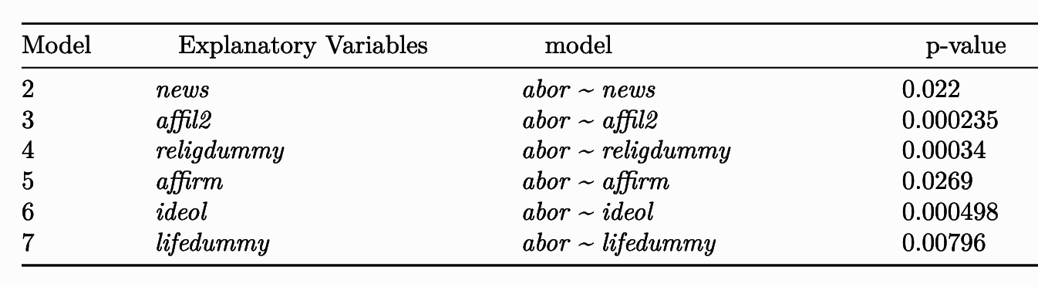
We choose variables that have a p-value < 0.2
Notes:
Brian
After we create the dummy variables for life, relig and affil , we test the relationship between our target and all variables one by one to see which variables are significance or useful as predictor. These variables that show on table, we choose these because they have p-value < 0.2.
.

Slide 16
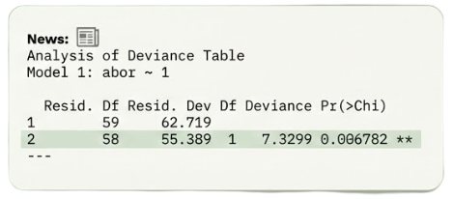
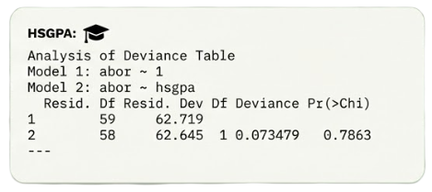
Compare models with sole predictors to null model
News:
Analysis of Deviance Table
Model 1: abor ~ 1
Resid. Df Resid. Dev Df Deviance Pr(>Chi)
1 59 62.719
2 58 55.389 1 7.3299 0.006782 **
---
HSGPA:
Analysis of Deviance Table
Model 1: abor ~ 1
Model 2: abor ~ hsgpa
Resid. Df Resid. Dev Df Deviance Pr(>Chi)
1 59 62.719
2 58 62.645 1 0.073479 0.7863
---
Notes:
Ankur

Slide 17
Initial Main Effects Model
abor ~ news + affil2 + religdummy + affirm + ideol + lifedummy
Notes:
Brian
From doing that things, now we got the initial main effect model contain news, affirm, ideol, affil2, religdummy and life dummy that catherine explain before.

Slide 18

Step 2: Backwards Elimination
Notes:
Catherine

Slide 19
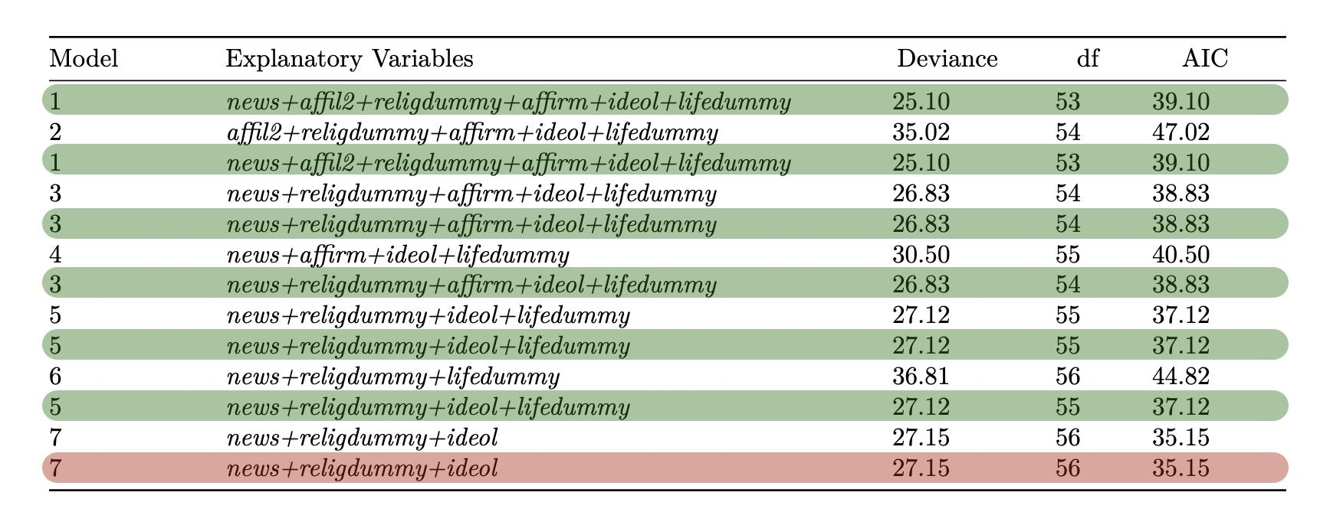
Notes:
Catherine

Slide 20

Step 3: Add Back Variables
Notes:
Ankur

Slide 21
Outcome: None of the added back variables significantly improved the model
tv:
Analysis of Deviance Table
Model 1: abor ~ tv + news + religdummy + ideol
Model 2: abor ~ news + religdummy + ideol
Resid. Df Resid. Dev Df Deviance Pr(>Chi)
1 55 26.290
2 56 27.153 -1 -0.86369 0.3527
---
COGPA:
Analysis of Deviance Table
Model 1: abor ~ cogpa + news + religdummy + ideol
Model 2: abor ~ news + religdummy + ideol
Resid. Df Resid. Dev Df Deviance Pr(>Chi)
1 55 27.113
2 56 27.153 -1 -0.039971 0.8415
---
AGE:
Analysis of Deviance Table
Model 1: abor ~ age + news + religdummy + ideol
Model 2: abor ~ news + religdummy + ideol
Resid. Df Resid. Dev Df Deviance Pr(>Chi)
1 55 26.523
2 56 27.153 -1 -0.62999 0.4274
Notes:
Ankur

Slide 22

Step 4: Add Interaction Terms
Notes:
Ankur

Slide 23
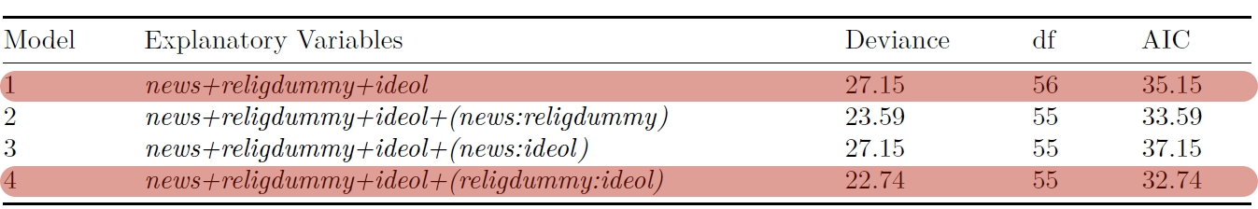
Comparison Between Simple Model and Models with Interaction
Notes:
Catherine

Slide 24
04
Model Testing
Notes:
Catherine

Slide 25
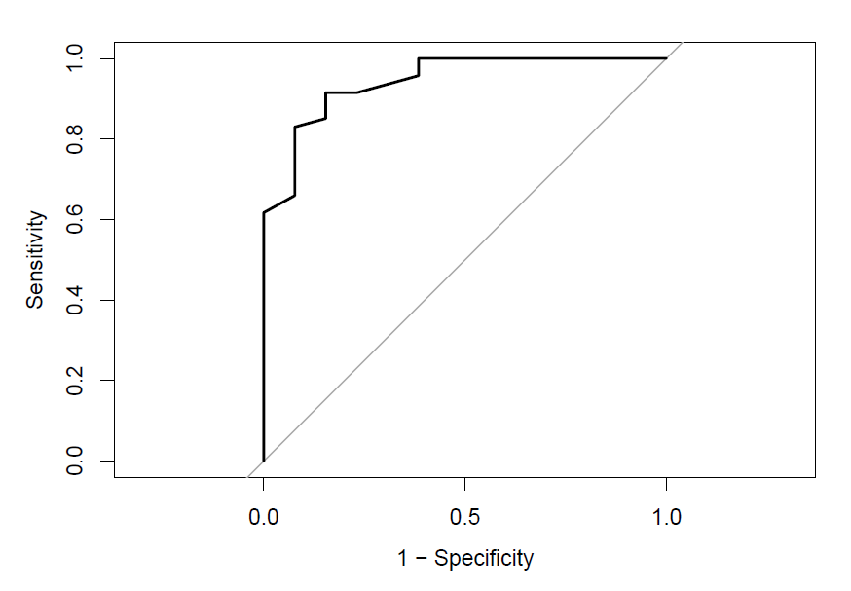
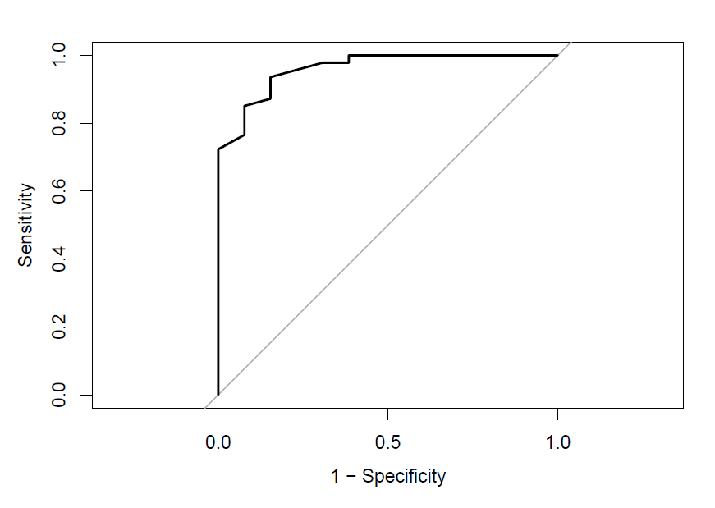
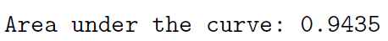
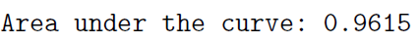
Simple Model
Complex Model
Notes:
Catherine

Slide 26
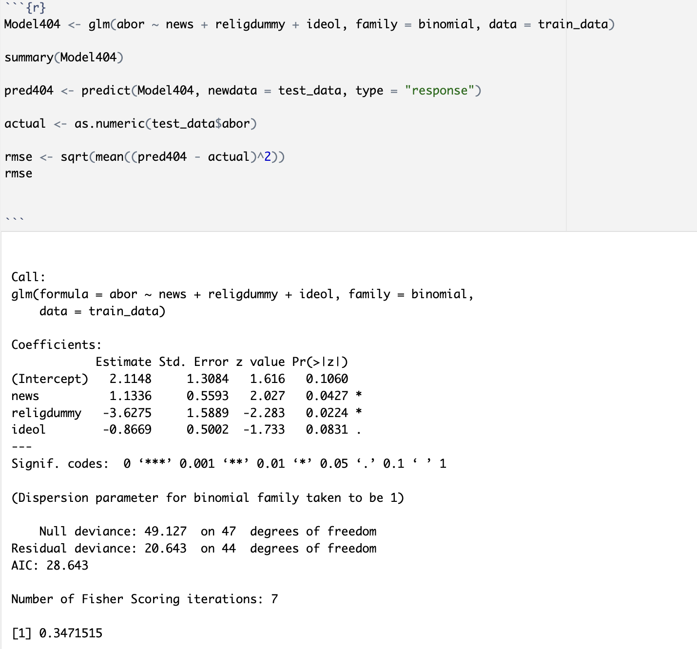
Making Predictions:
RMSE for Simple Model
Notes:
Ankur

Slide 27
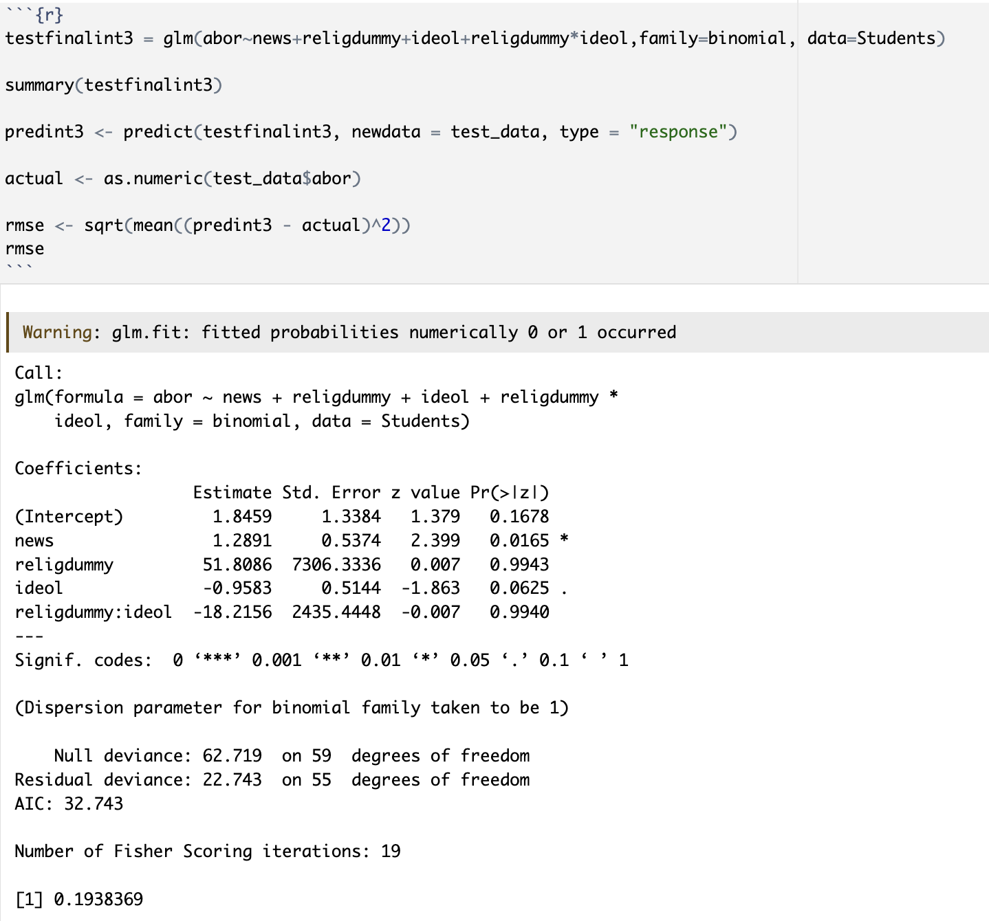
Making Predictions:
RMSE for Complex Model
Notes:
Ankur

Slide 28
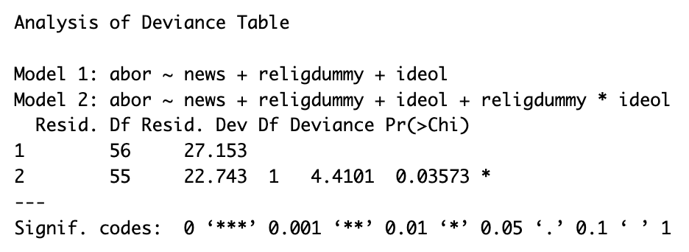
Anova Test Between Simple and Complex Model
Notes:
Brian
We need to compare between two model, one is simpler model and another one is complex model.
So we set the null - simpler model is doing better and alternative hypothesis - complex is better
and do the anova test.
This is a result — P-value is 0.03573 less than 0.05. So we reject the null hypothesis. The complex model is better.

Slide 29
05
Final model
Notes:
Catherine

Slide 30
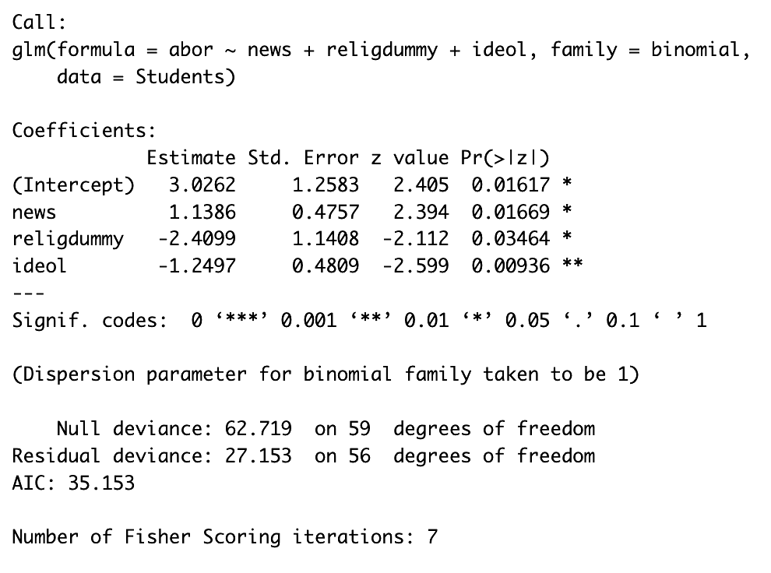
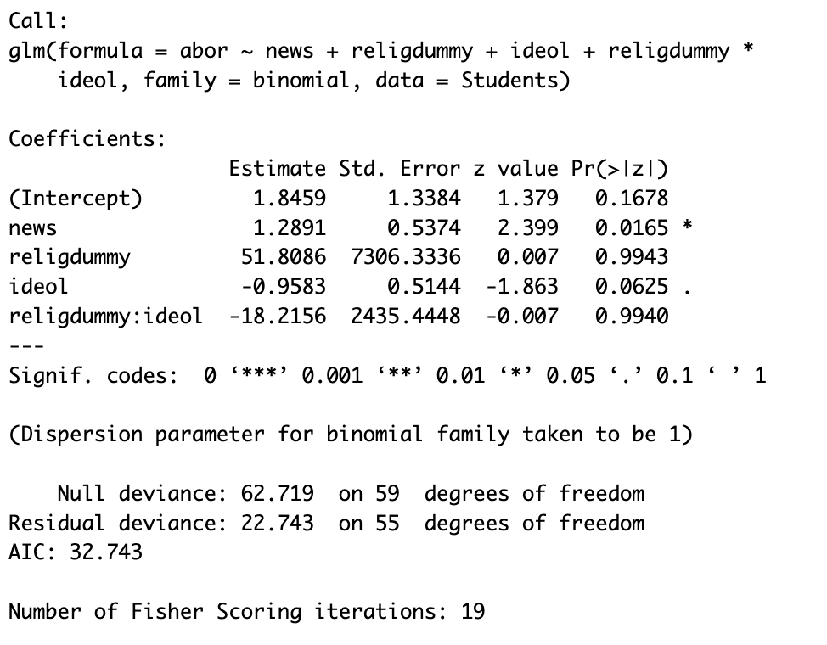
Simple or Complex Model?
Notes:
Catherine/Ankur

Slide 31
Thank you

